Slide 1
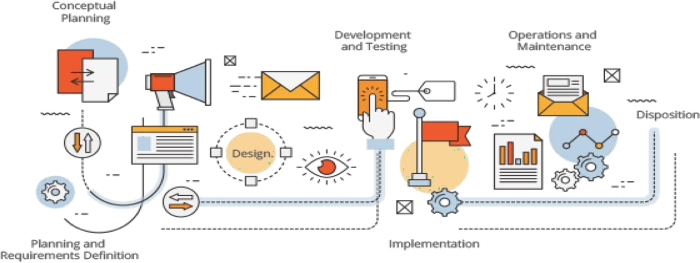

Software Engineering
Software Process Models – Agile Models
CS 3009 - Software Engineering
NATIONAL UNIVERSITY OF COMPUTING AND EMERGING SCIENCES
Dr. Syeda Javaria Imtiaz
NATIONAL UNIVERSITY OF
COMPUTING AND EMERGING SCIENCES

Slide 2
XP Practices Revision
Faster feedback
  Test driven development
  Onsite customer
  Pair programming
Continuous process
  Continuous integration
  Refactoring
  Short releases
Shared understanding
  The planning game
  Simple Design
  System Metaphor
  Collective ownership
  Coding Standards
Developers welfare
  40-Hour Week

Slide 3
Kanban Methodology: The Simplest Agile Framework
"Kanban" (かんばん) is a Japanese word that translates directly as "visual card."
This methodology, Kanban involves creating visual cards that list details about a task and organizing them into lists on a board that represent different stages of a production process.
History: The Kanban methodology was invented by Toyota back in the 1950s as a way of organizing car factory floors and ensuring each car part was made with the same level of care at every step.
Back then, the Kanban methodology was managed with Post-it notes on a whiteboard.
As a Toyota factory worker, you'd know where to pick up work on a part, thanks to its Kanban card detailing progress and production stage."
Today, Kanban boards have evolved from factory whiteboards to our computer screens in the form of digital Kanban apps.

Slide 4
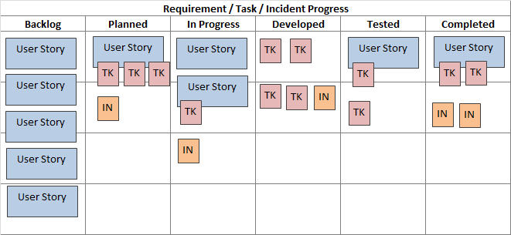
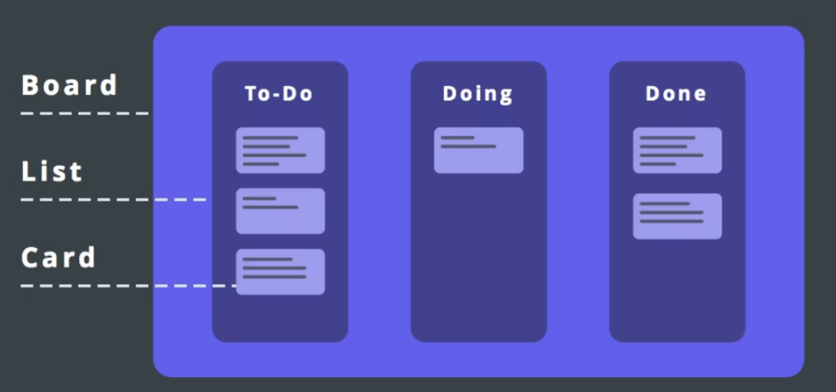
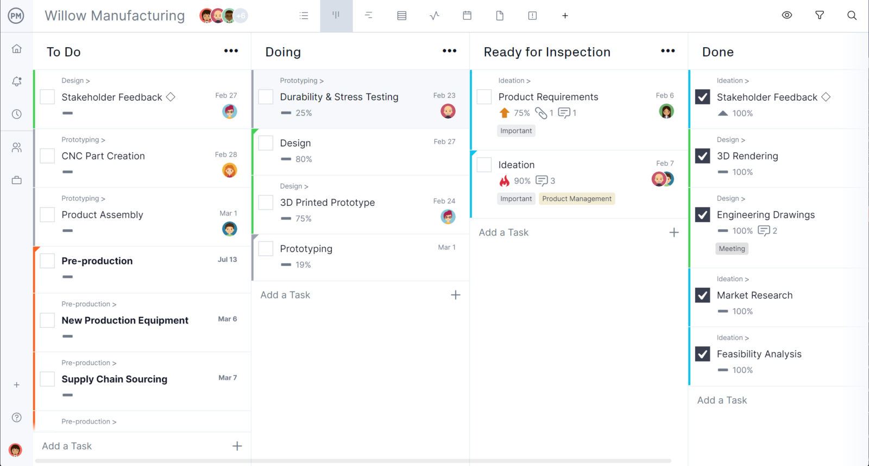
What is a Kanban board?

Slide 5
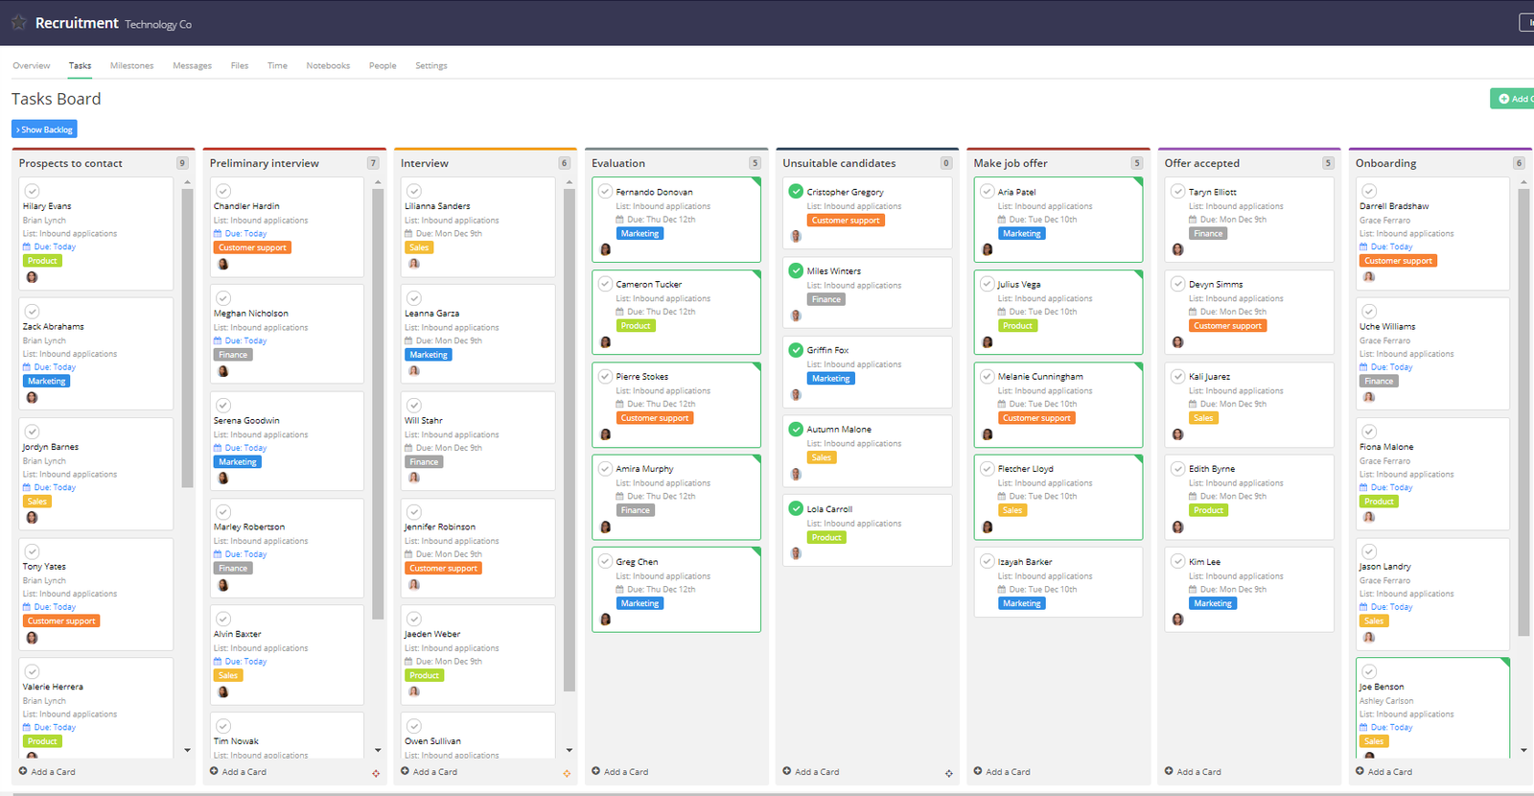

Slide 6
What Kanban is not
Technically, it would be incorrect to say that the Kanban method is a project management framework because it doesn’t provide the guidelines on how the project must be executed. Scrum, Lean, Waterfall, and other methodologies go into great detail in talking about the stages that projects must go through and the rituals that must accompany those stages. Kanban, however, is best used as an add-on to one of those methodologies, like Agile, for example.
It is also not rare to see companies using a hybrid of Scrum and Kanban (also known as Scrumban).
Kanban boards, in turn, are a great tool that helps manage tasks, balance the workload, and get an instant glance at the state of things

Slide 7
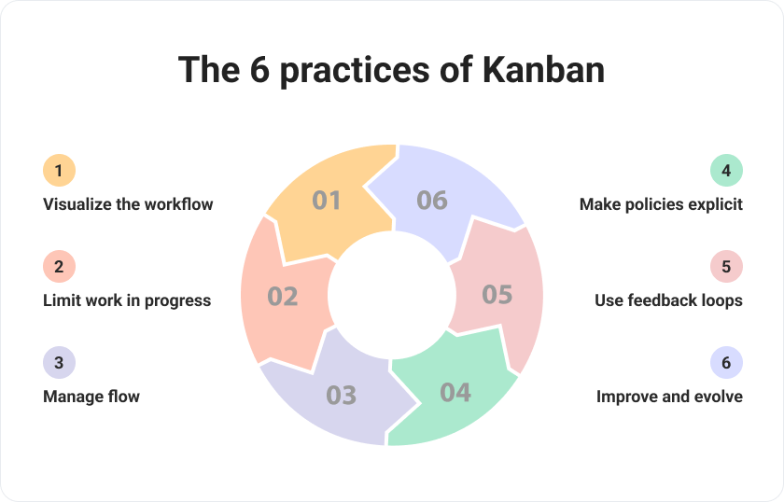
"Kanban systems are loved for visualizing work. The Kanban board tracks tasks from start to finish, providing clear progress visibility."
"Kanban doesn’t set process rules, but they must be clear to the team. In an ideal setup, tasks flow smoothly without delays from confusion."
"Kanban emphasizes WIP limits to boost efficiency and early delivery. By focusing on fewer tasks at a time, teams reduce cycle time and improve workflow. The ideal WIP limit is team-specific and flexible."
"Kanban feedback loops come from both clients and the team. Clients assess quality and usability, while the team shares insights on processes and improvements."
"Kanban’s core practices work together, especially managing workflow to support WIP limits. The goal is to move tasks smoothly through each stage by removing obstacles like delays or unnecessary steps. Online time management tools can help simplify this process."
"Kanban's sixth practice encourages continuous improvement. Stay open to new ideas, tools, and experiments. If time is a concern, try techniques to learn faster or use time management software."

Slide 8
How does Kanban work? The Kanban board
Work items (tasks) are pulled from the backlog into the workflow with the key working tool being the Kanban board.
The Kanban board has a number of columns that can look different for each team. However, most Kanban boards have the following columns:
  To do
  Work in progress
  Done
All tasks are placed on the Kanban board to demonstrate the complete workload of the team or individual.
Each task is assigned a dedicated Kanban card that includes the following information:
  Name
  Description
  Deadline
  Assigned team member (if applicable)

Slide 9
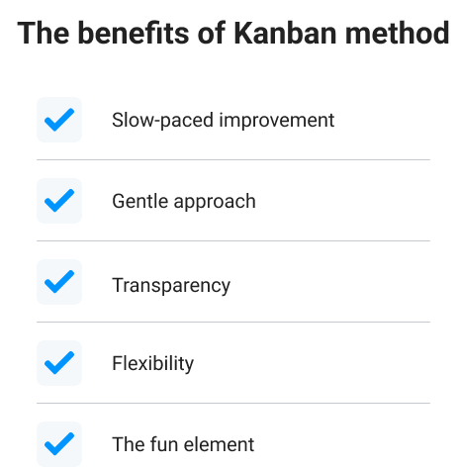
Notes:
kanban is not unique in its focus on continuous improvement, it stands out through slow and smooth integration into the team’s working process.
Transparency
It is very transparent – everyone knows what others are doing, every team member’s online week planner is visible, the workload is clear, and any bottlenecks can be spotted right away.
In many teams, especially when it comes to software development, the key role of the project manager is to guide the team and facilitate their work, instead of actively managing and standing in the way. The levels of transparency and visibility that Kanban offers leave PMs assured that their teams know what they should be doing and when. As a result, such a non-invasive yet efficient system boosts creativity and promotes focus on important tasks.

